Slide 1
Counter (RTL to GDS Flow)
Date: 17/07/2024
Group-4
Created by:
Tirth Chauhan
Shahid Chopda
Nandini Vajani
Harsh Kapadiya
Hani Prajapati

Slide 2
Introduction
The RTL to GDS flow is a comprehensive process in the design and manufacturing of integrated circuits (ICs). It involves translation of a high-level hardware description (RTL) into a final layout that can be fabricated on a silicon chip (GDSII).
Benefits of RTL to GDS Flow:
Ensuring Design Accuracy and Functionality
Optimization of Performance, Area, and Power
Testability
Efficient Use of Resources
Meeting Timing Constraints
Power Integrity
Physical and Logical Verification
Preparation for Manufacturing
Time-to-Market
Quality and Reliability

Slide 3
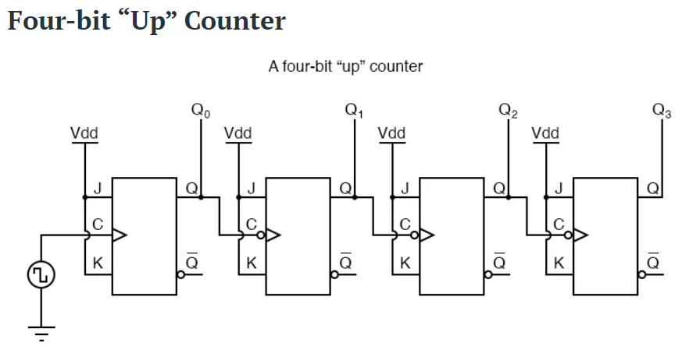
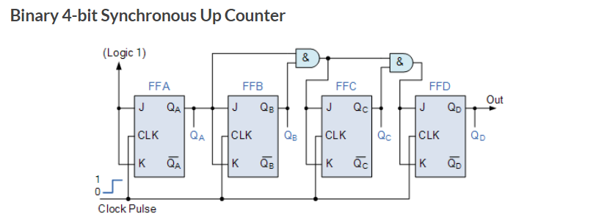
Understanding the Counter
Definition of a Counter:
A counter is a sequential circuit that counts pulses, consisting of flip-flops triggered by a clock signal.
Types of Counters:
Asynchronous Counters:
Flip-flops connected in series; the clock signal is applied to the first flip-flop (FF-A).Output of FF-A serves as the clock for FF-B.
Ex:- Ripple UP counter, Ripple DOWN counter.
Synchronous Counters:
All flip-flops receive the same clock signal simultaneously.
Eliminates counting and propagation delays.
FF-A operates as a toggle flip-flop; its output drives the next flip-flop.
Ex:- Ring counter, Johnson counter.

Slide 4
RTL Design and Simulation
RTL (Register Transfer Level) design represents a circuit's functionality and data flow using hardware description languages (HDLs).
Simulation:
Verify the functionality of the RTL design through simulation tools.
Counter Design in RTL(HDL Code):
module counter ( input clk,
input rstn,
output reg [3:0]);
always @ (posedge clk) begin
if (!rstn)
out <= 0;
else
out <= out + 1;
end
endmodule
Test bench:
`timescale 1ns / 1ps
module tb_counter();
reg clk;
reg rstn;
wire [3:0] out;
counter uut (.clk(clk), .rstn(rstn), .out(out));
always #5 clk = ~clk;
initial begin
$monitor("Time: %0d, out: %b", $time, out);
clk = 0; rstn = 0;
#10;
rstn = 1;
#100;
$stop;
end
endmodule

Slide 5
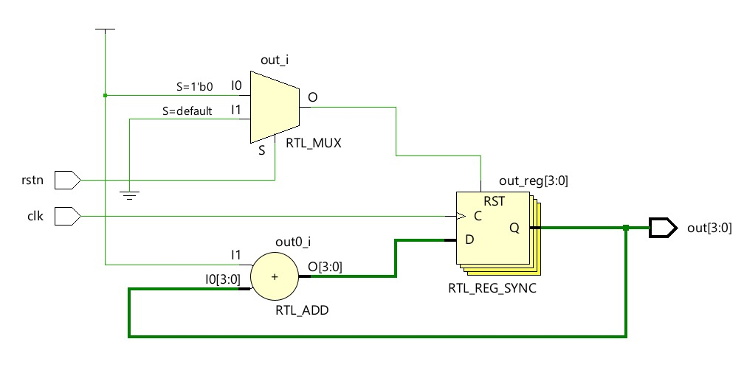
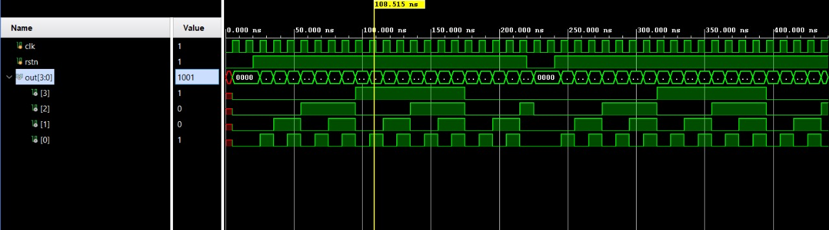
RTL Design and Simulation
1. RTL Schematic
2. Simulation Waveform

Slide 6
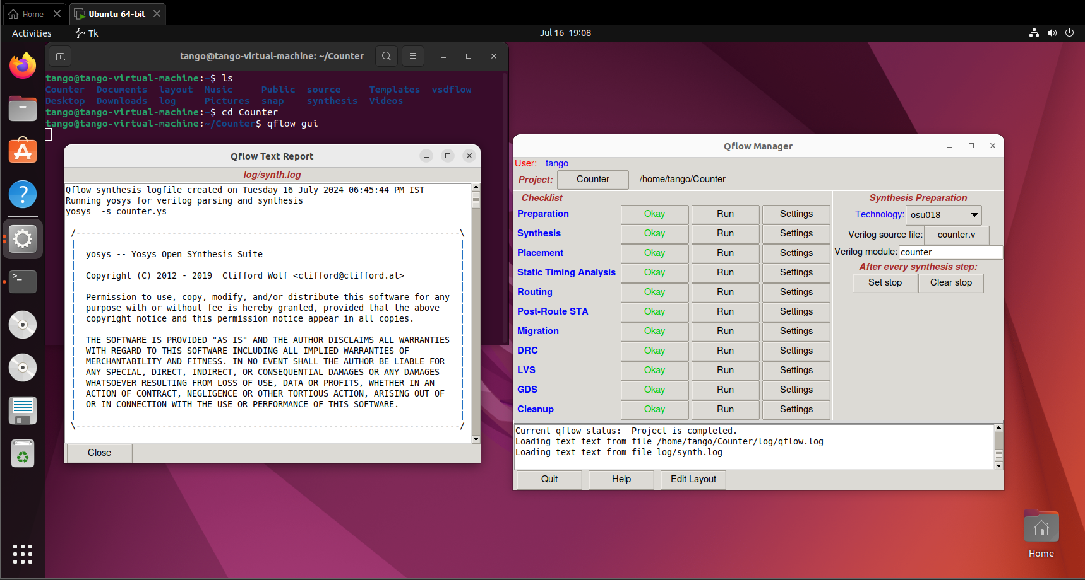
Preparation and Synthesis
Preparation:
In The preparation step The technology for
synthesis is selected along with the HDL Code.
2. Synthesis:
Logical Synthesis:
Yosys: Converts Verilog code to Gate-Level netlist.
Technology Mapping:
Standard Cell Library: Map netlist to standard
cell library.
Optimization
Timing and Area: Optimizes netlist for performance
and size.
Formal Verification
Equivalence Checking: Verify netlist matches RTL
functionality.
Tool Used:
Yosys: Converts Verilog code to Gate-Level netlist

Slide 7
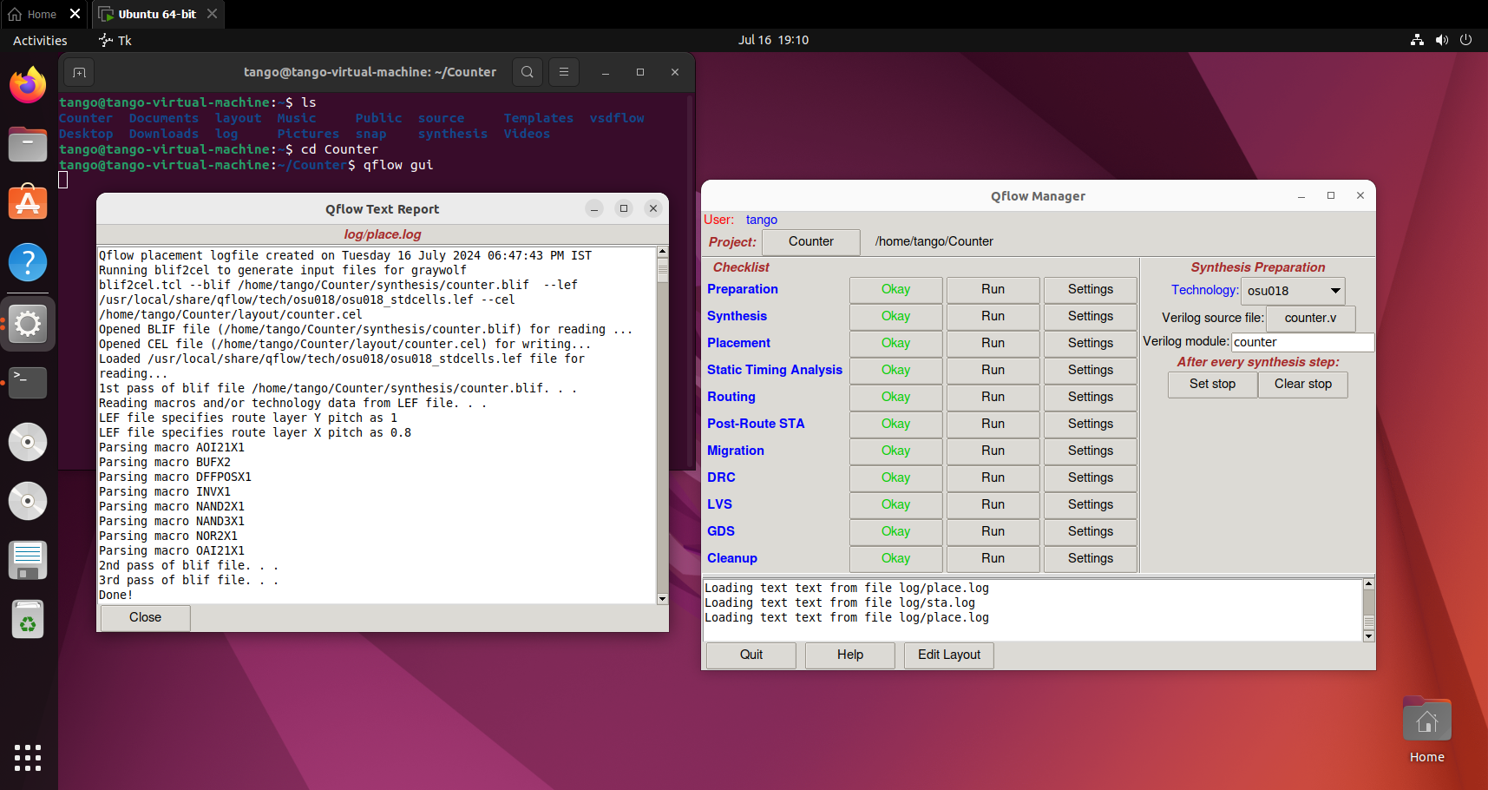
Placement
Arranges standard cells on the chip layout efficiently to optimize area, performance, and routing complexity.
1.Preparation:
In this step the gate level netlist is imported which
Was generated during Synthesis. Chip dimensions
and constrains are also defined.
2.Initial Placement:
Position cells to optimize global wire length and reduce
potential congestion. Adjust the initial placement to
balance cell distribution and prepare for detailed
placement.
3.Detailed Placement:
Ensure all cells are placed on valid locations, adhering to placement rules and Refine cell positions to improve timing, reduce wire length,
and meet design constraints.
4.Congestion Analysis:
Analyzes the placement to identify areas of potential routing congestion. Adjusts cell positions to alleviate congestion and improves routing
Tool Used:
graywolf:is an open-source tool for the placement of standard cells in VLSI design.

Slide 8
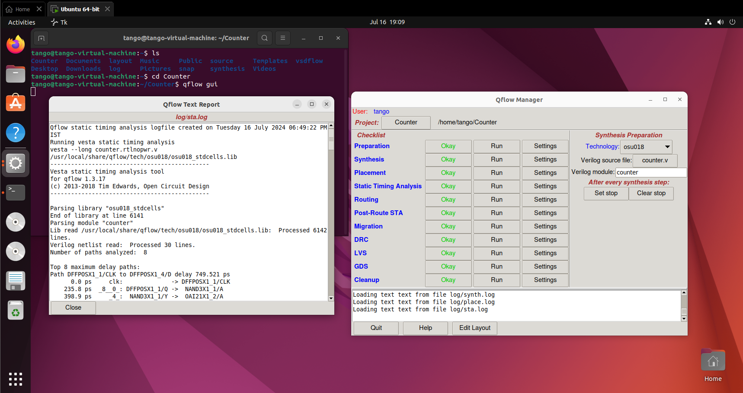
Static Timing Analysis (STA)
Ensures preliminary timing constraints are met to guide the routing process effectively.
1.Load Netlist
2. Define Timing Constraints
3. Identify Critical Paths
4. Perform Setup and Hold Checks
5. Estimate Delays
6. Account for Clock Skew and Jitter
7. Calculate Slack
8. Provide Optimization Guidance
9. Re-analyze Timing
10. Give Feedback
Tools Used :
OpenSTA: A popular open-source static timing analysis tool that provides fast and accurate timing analysis for digital designs

Slide 9
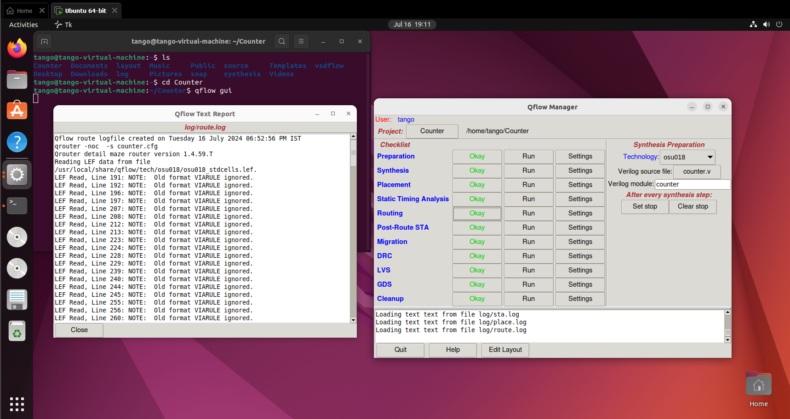
Routing
Routing is a critical step in the process of designing integrated circuits (ICs). Routing refers to the process of determining the physical paths that electrical signals will take between different components on an IC.
Importance of Routing:
Performance:
Signal Integrity:
Power Distribution:
Design Rule Compliance:
Tool Used :
QRouter: An Open Source tool specifically designed for detailed routing of IC designs.

Slide 10
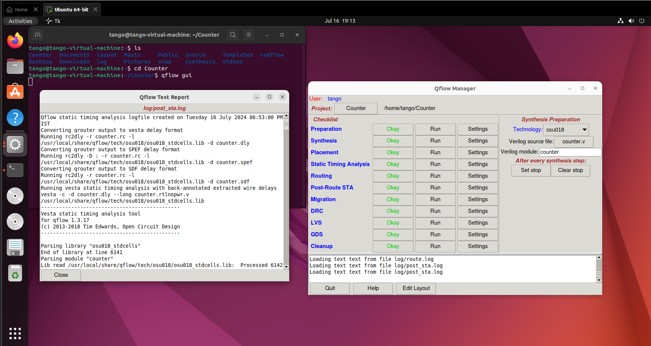
Post-Route STA
Post-Routing STA is used to verify that the circuit meets its timing requirements after the routing stage.
Importance of Post-Routing STA:
Timing Verification
Performance Optimization
Signal Integrity
Design Closure
Tool Used :
OpenSTA: A popular open-source static timing analysis tool that provides fast and accurate timing analysis for digital designs

Slide 11
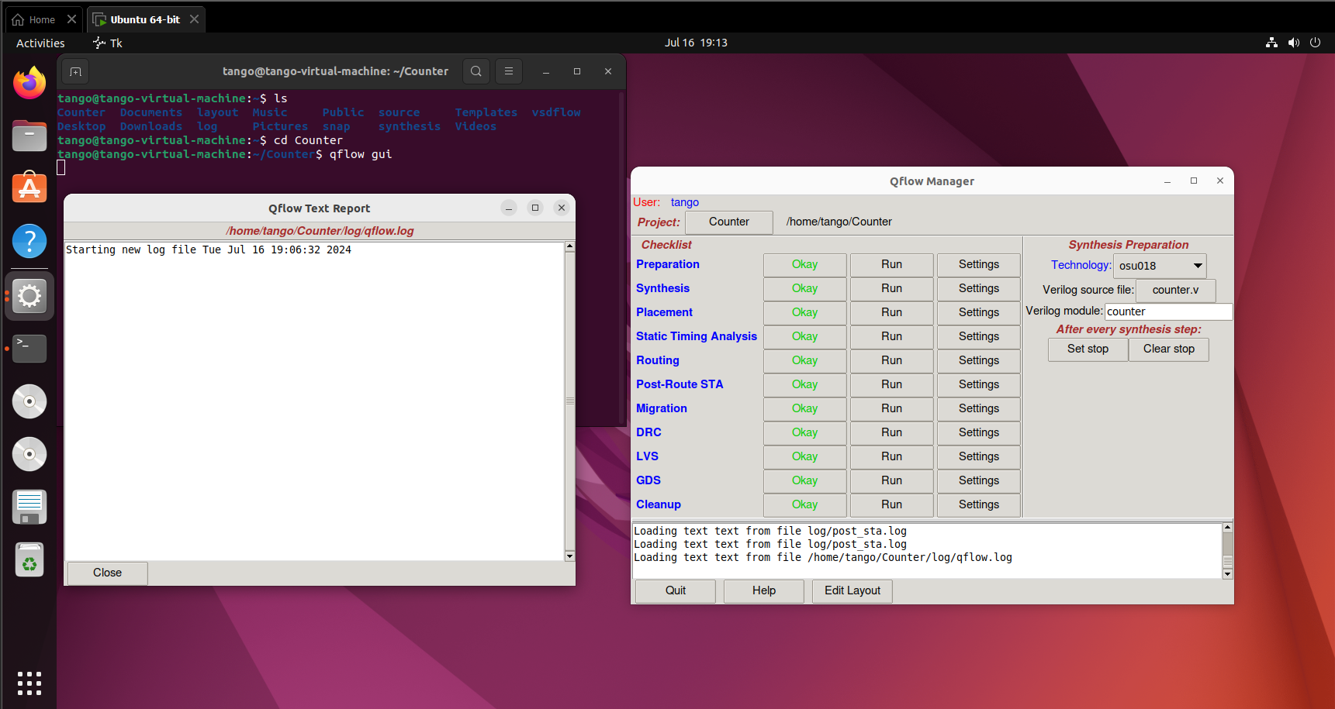
Migration
Migration in open-source Electronic Design Automation (EDA) tools generally refers to the process of adapting a design to a different technology node, process, or design environment. This can involve various activities such as scaling the design, updating libraries, and adjusting for new process parameters.
Importance of Migration
Adoption of New Technology
Cost Efficiency
Obsolescence Management
Performance Enhancements
Tool Used :
Magic: A synthesis tool that can be adapted for different technology libraries, assisting in the re-synthesis of designs for new processes.

Slide 12
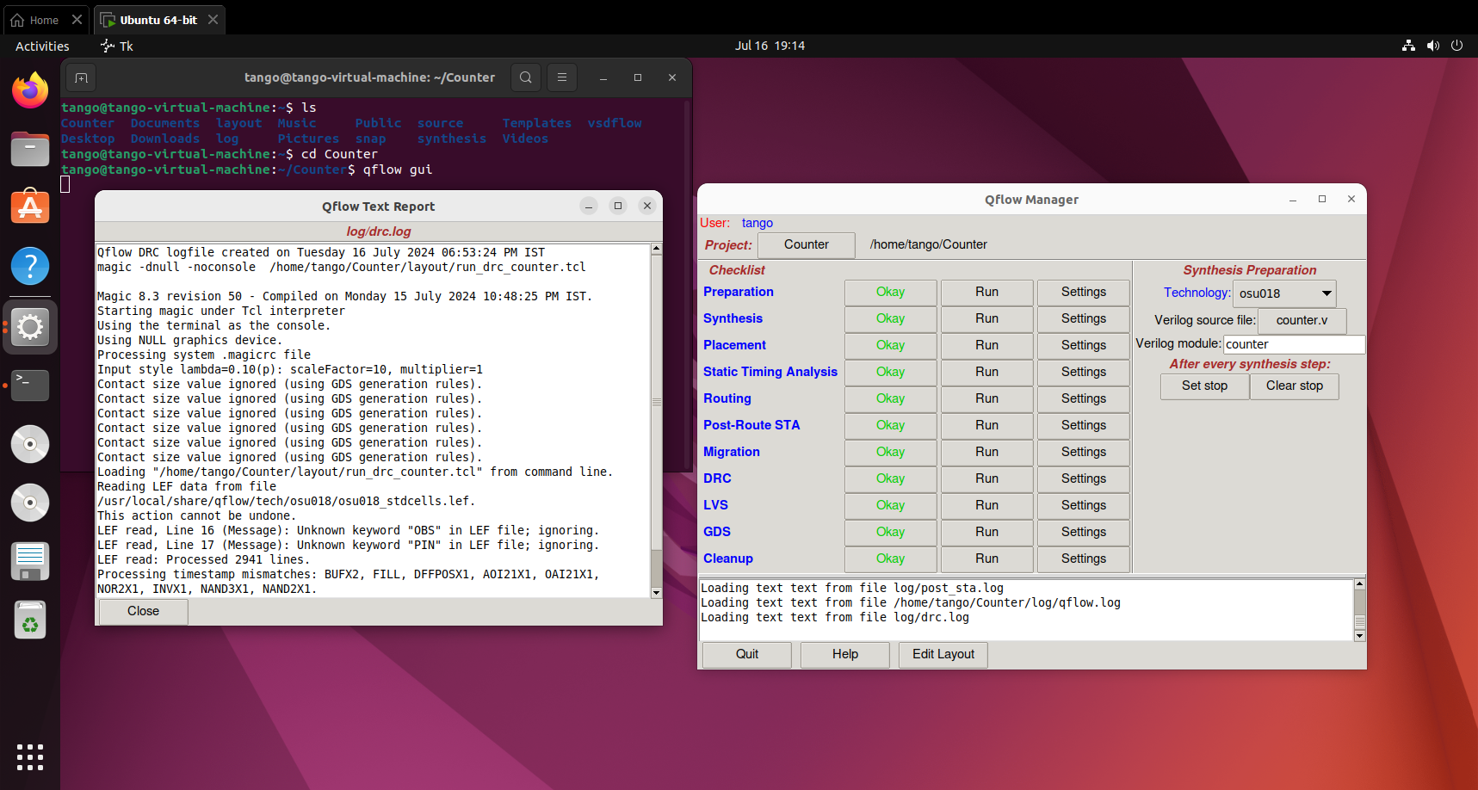
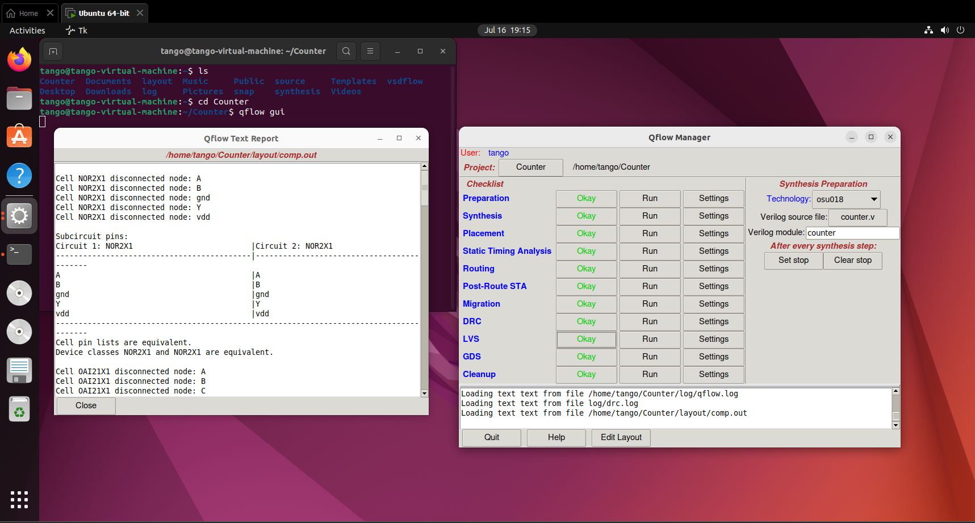
DRC
Design Rule Checking (DRC):
Ensures a layout adheres to the physical and geometric constraints specified by the fabrication process.
Importance:
Manufacturability: Ensures that the design can be manufactured without issues.
Quality Assurance: DRC helps maintain high-quality standards.
Tool used:
Magic: Includes robust DRC capabilities.
LVS
Layout Versus Schematic (LVS) is a verification process used in integrated circuit (IC) design to ensure that the physical layout of the circuit accurately represents the intended schematic design.
Importance:
Error Detection, Fabrication Readiness,
Design Integrity.
Tools used:
netgen: Compare the netlist extracted from physical layout with design netlist

Slide 13
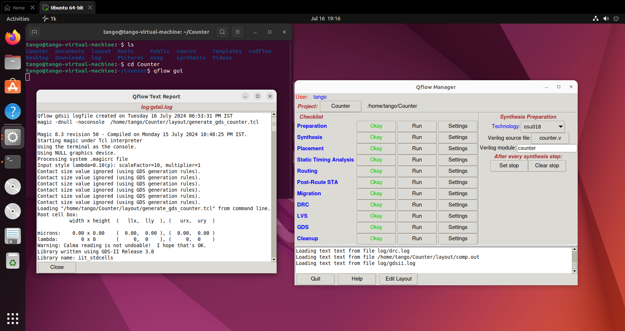
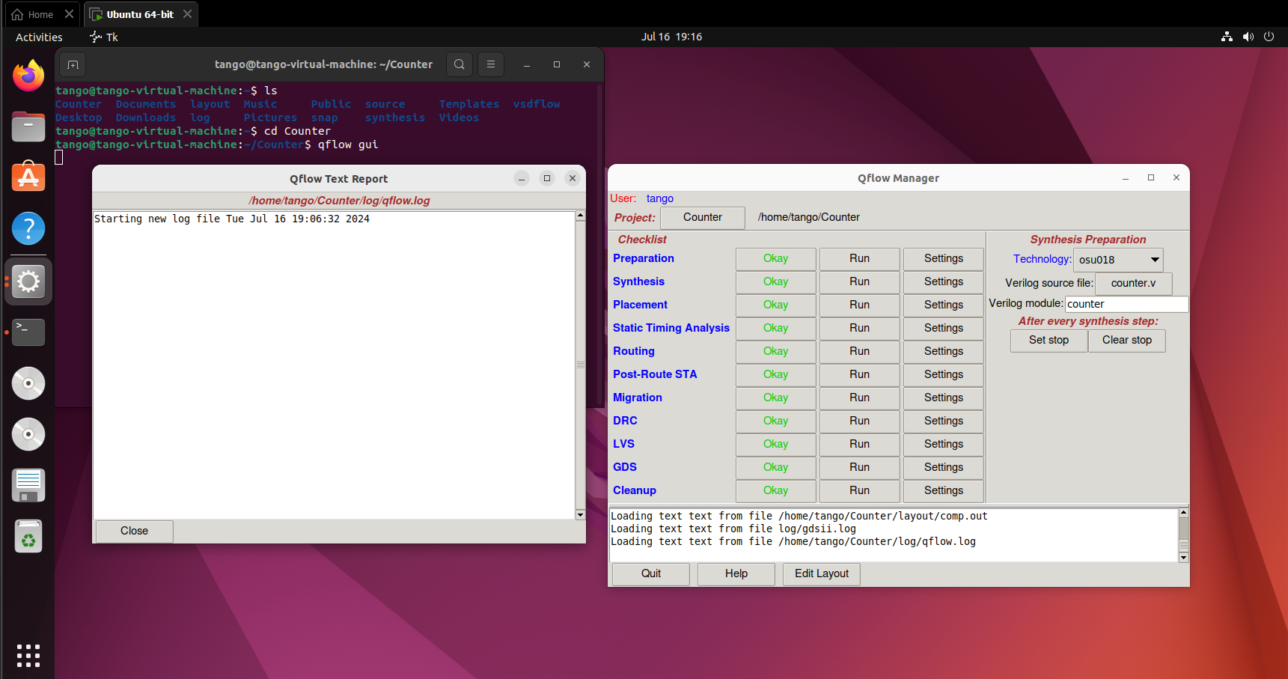
GDS
GDS (Graphic Data System) is a file format used for the exchange of integrated circuit (IC) layout data. It is the industry standard format for representing the physical layout of IC designs.
Importance:
Industry Standard, Fabrication Ready
Tools used:
Magic: An open-source VLSI layout tool that supports GDS export and import, allowing designers to work with industry-standard layout data.
Cleanup
Cleanup refers to the process of refining the layout of an integrated circuit (IC) design to ensure it meets various design requirements and is ready for fabrication
Importance:
Design Quality
Error Prevention
Tool used:
Magic: layout cleanup, such as DRC and layer management.

Slide 14
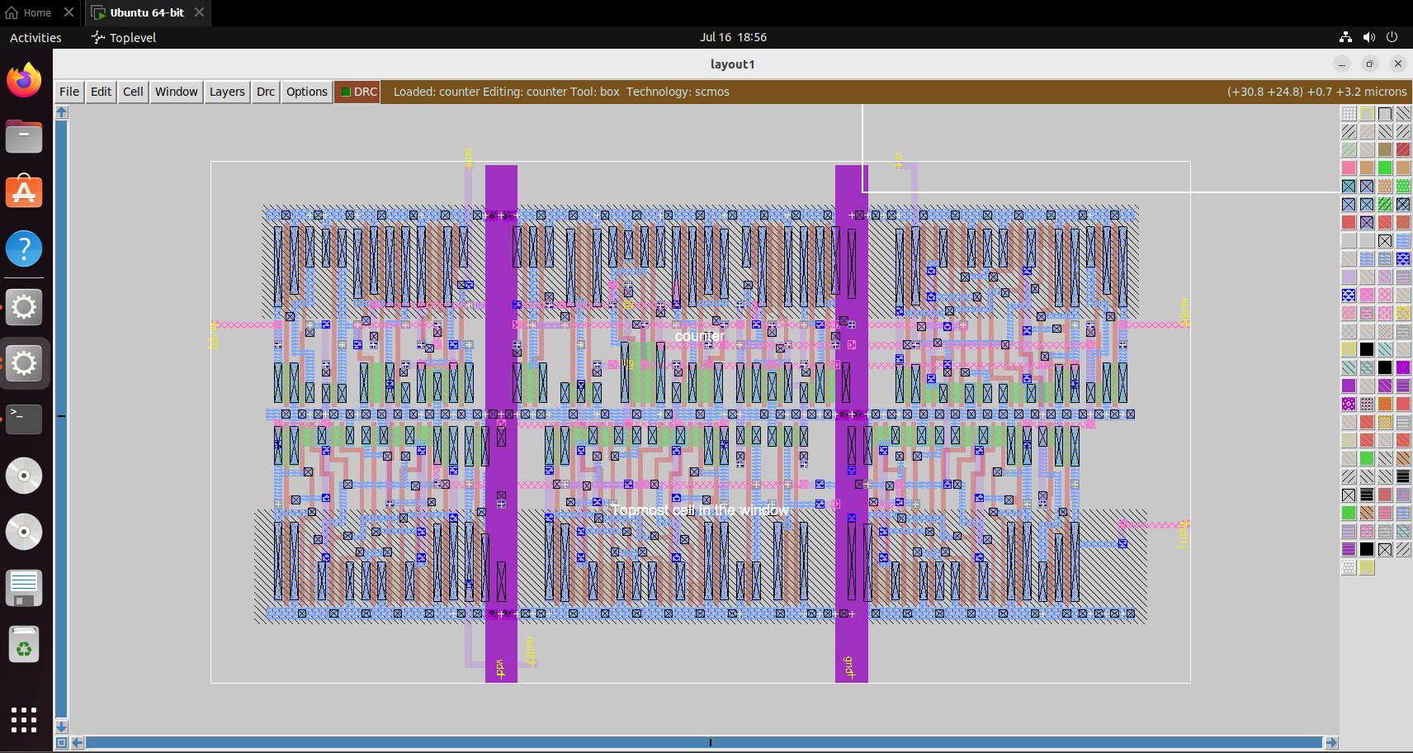
Layout

Slide 15
References
YouTube: https://youtu.be/5fm_YmcoTiU?si=qoo7myYsp0YhpRwm
javapoint: https://www.javatpoint.com/verilog-4-bit-counter
Electronics Tutorial: https://www.electronics-tutorials.ws/counter/count_3.html
All About Circuits: https://www.allaboutcircuits.com/textbook/digital/chpt-11/asynchronous-counters/
Thank You

